Slide 1
Persecution of minorities
The idea of the Aryan race
Eugenics
Nuremberg Laws
Kristallnacht

Slide 2
Origin of the Aryan
The word Aryan comes from the ancient languages of Iran and India. It was the term that ancient Indo-Iranian-speaking people likely used to identify themselves in the period around 2000 B.C.E.
It is thought to mean ‘a noble one’.
By the early 20th century, Alfred Rosenberg and other northern European "thinkers" had taken the idea of the pure Nordic Aryan and turned it into a "religion of the blood."
Calling for the annihilation of racially inferior, non-Aryan types of people in northern Europe - Untermenschen, or subhumans, included Jews, Roma, and Slavs, as well as Africans, Asians, and Native Americans.
It was a short step for Adolf Hitler and his lieutenants to move from these pseudoscientific ideas to the concept of a "Final Solution" for the preservation of so-called "Aryan" purity. In the end, this linguistic designation, combined with a heavy dose of Social Darwinism, gave them a perfect excuse for the Holocaust, in which the Nazis targeted the Untermenschen for death by the millions.

Slide 3
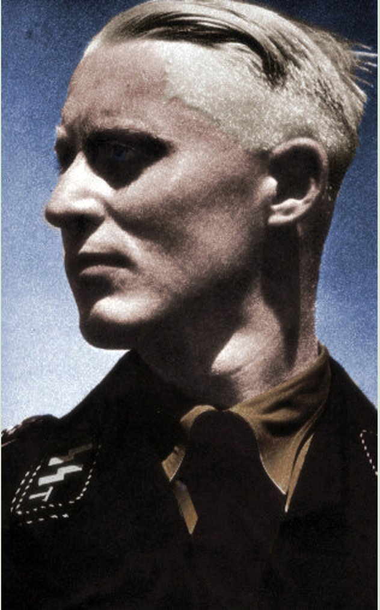
Hitler’s Aryans
https://www.washingtonpost.com/news/morning-mix/wp/2014/07/07/the-perfect-aryan-child-the-nazis-used-in-propaganda-was-actually-jewish/?noredirect=on
For Hitler, the ideal "Aryan" was blond, blue-eyed, and tall.
Tests were developed to decide who were ideal Aryans.
Matching hair colours
Measuring dimensions of the face
SAMUEL GRUBER DESCRIBES A GERMAN GIRL'S REACTION TO LEARNING THAT HE WAS JEWISH: https://encyclopedia.ushmm.org/content/en/oral-history/samuel-gruber-describes-a-german-girls-reaction-to-learning-that-he-was-jewish?parent=en%2F11128

Slide 4
The Nazi Race, 1929
“The Nordic (Aryan) race is tall, long-legged, slim…male height of above 1.74m. The race is narrow-faced with a narrow forehead, a narrow high-built nose and a lower jaw and prominent chin, the skin is rosy bright and blood shines through…the hair is smooth, straight or wavy – possibly curly in childhood. The colour is blonde.”

Slide 5
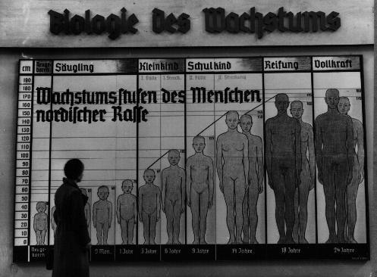

Slide 6
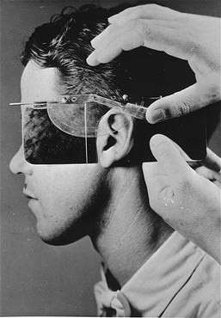
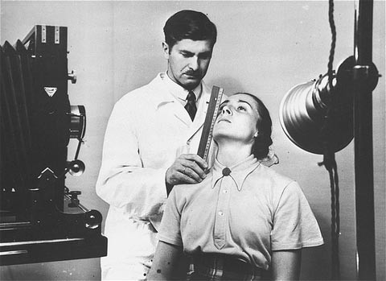

Slide 7
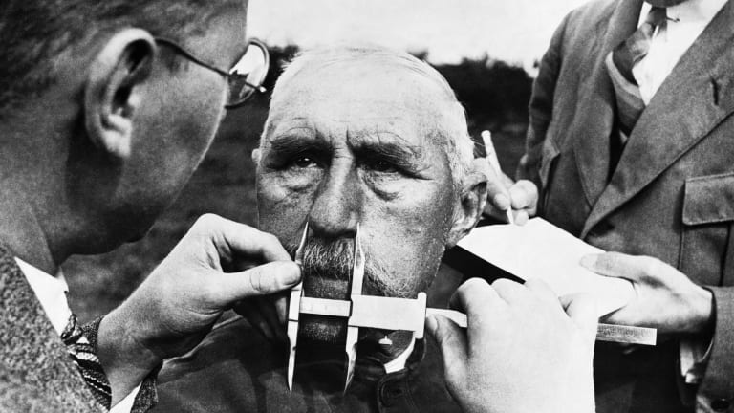
Eugenics
The science of improving a population by controlled breeding to increase the occurrence of desirable heritable characteristics.
Nazi policy encouraged racially "acceptable" couples to have as many children as possible.
On July 14, 1933, the Nazi dictatorship fulfilled the long-held dreams of eugenics proponents by enacting the Law for the Prevention of Genetically Diseased Offspring, based on a voluntary sterilization law drafted by Prussian health officials in 1932.
https://encyclopedia.ushmm.org/content/en/photo/gerda-d-was-sterilized-after-a-disputed-diagnosis-of-schizophrenia?parent=en%2F9301

Slide 8
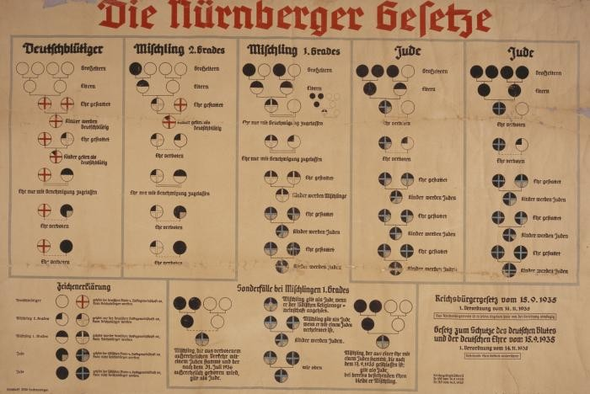
Nuremberg laws
Two distinct laws passed in Nazi Germany in September 1935 are known collectively as the Nuremberg Laws: the Reich Citizenship Law and the Law for the Protection of German Blood and German Honor.
These laws embodied many of the racial theories underpinning Nazi ideology.
They would provide the legal framework for the systematic persecution of Jews in Germany.
According to the Reich Citizenship Law and many clarifying decrees on its implementation, only people of “German or kindred blood” could be citizens of Germany. The law defined who was and was not a German, and who was and was not a Jew. The Nazis rejected the traditional view of Jews as members of a religious or cultural community. They claimed instead that Jews were a race defined by birth and by blood.
https://encyclopedia.ushmm.org/content/en/film/nuremberg-laws-proclaimed?parent=en%2F11475
https://encyclopedia.ushmm.org/content/en/photo/fritz-gluecksteins-family-on-an-outing?parent=en%2F11475

Slide 9
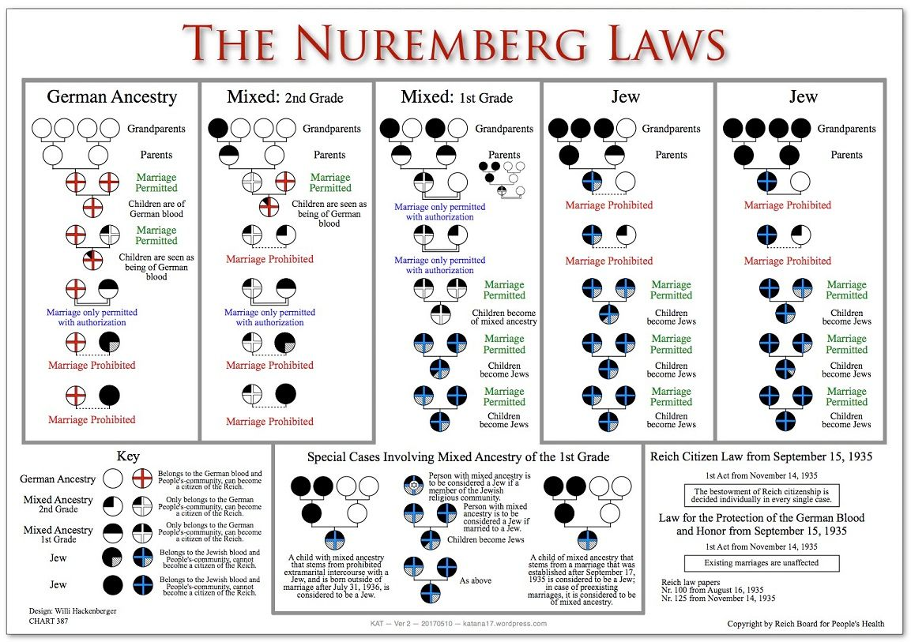

Slide 10
How did the Nazis treat the Jews from 1933 to 1939?
1933
April – Official one-day boycott of Jewish shops, lawyers and doctors all over Germany.
1934
Anti-Jewish propaganda increased.
1935
May – Jew forbidden to join the army.
September – The Nuremberg Laws; Law for the Protection of German Blood and Honour – banned marriages between Jews and Aryans, and forbade them to have sexual relations outside of marriage. Reich Citizenship Law – made Jews ‘subjects’ rather than citizens and they lost certain rights.
1936
There was a lull in the anti-Jewish campaign as the Berlin Olympics were taking place, anti-Jewish signs were taken down.
1937
September – For the first time in two years, Hitler made an outspoken attack on the Jews. The Aryanisation of business was stepped up – more Jewish businesses were confiscated.
1938
April – Jews had to register their property, making it easier to confiscate.
June-July – Jewish doctors, dentists and lawyers were forbidden to treat Aryans.
October – Jews had to have a red letter ‘J’ stamped on their passports.
9-10 November – Kristallnacht; Nazis destroyed synagogues, Jewish homes and shops.

Slide 11
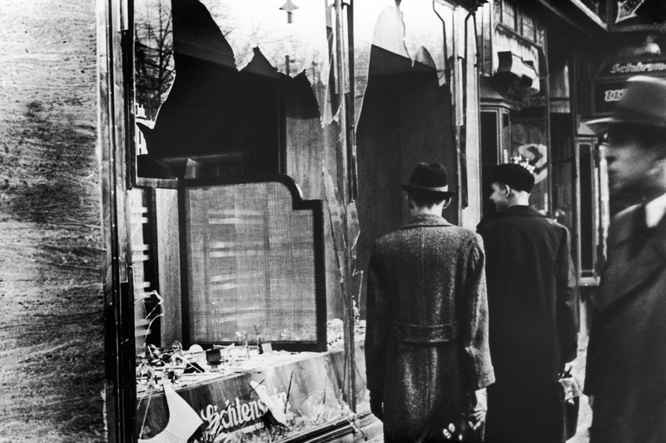
Kristallnacht
On November 9–10, 1938, Nazi leaders unleashed a series of attacks against the Jewish population in Germany .
This event came to be called Kristallnacht (The Night of Broken Glass) because of the shattered glass that littered the streets after the vandalism and destruction of Jewish-owned businesses, synagogues, and homes.
During the attacks, some 30,000 Jewish males were rounded up and taken to concentration camps. This unprecedented violence against the Reich’s Jews generated international outrage.
https://encyclopedia.ushmm.org/content/en/oral-history/johanna-gerechter-neumann-describes-kristallnacht-in-hamburg?parent=en%2F4063

Slide 12
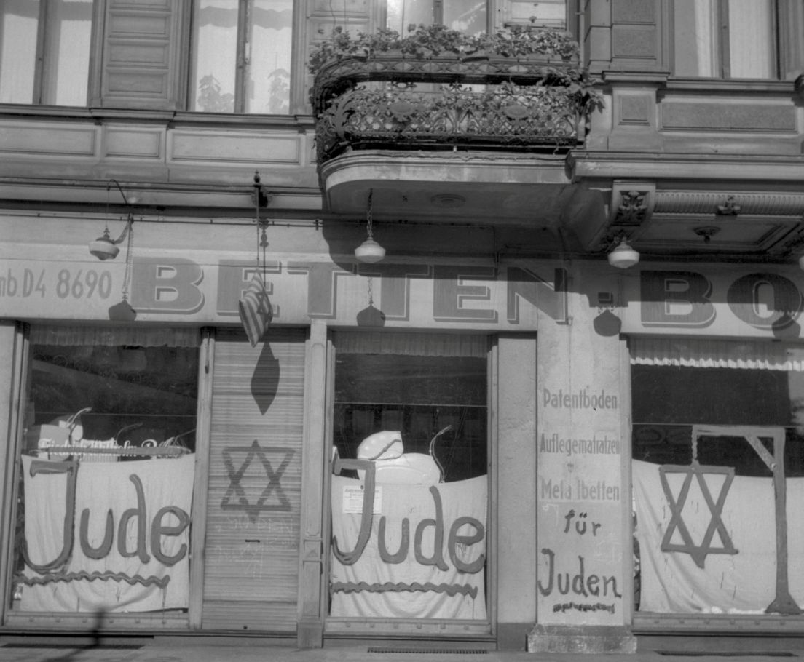

Slide 13
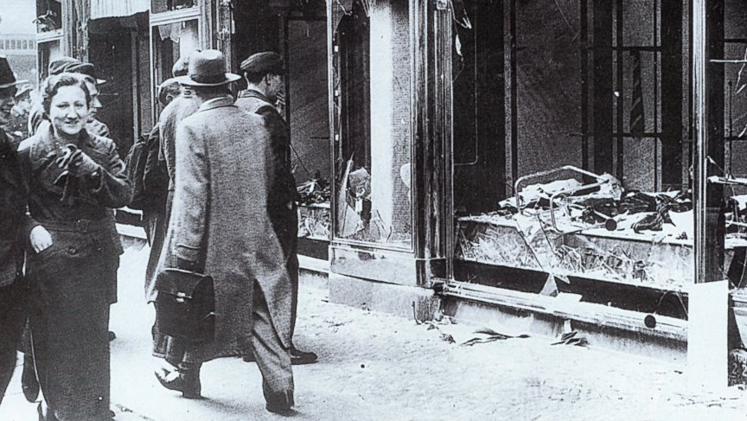

Slide 14
Report of Reinhardt Heydrich, Chief of Security Police, on the damage, dated 11 November
“Shops – 815 destroyed
Synagogues – 276 destroyed
Jews – 20,000 arrested
Foreigners – 3 arrested
Looting – 174 looters arrested”
Heydrich noted: ‘The true figures must be several times greater than those reported.’
How could this source be contested?

